Slide 1
Unit 4 – Sequential Processing
Instructor: Brent Presley

Slide 2
Reading for this unit
Chapter 3

Slide 4
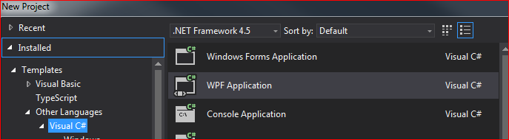
Intro to wpf
Wpf = windows presentation foundation
An upgrade to windows forms
From within Visual Studio, it’s a selection under “Visual C#”

Slide 5


Comparison to forms
Similar layout
Similar property names
Better at colors and display/presentation
Easier to create/edit your display

Slide 6
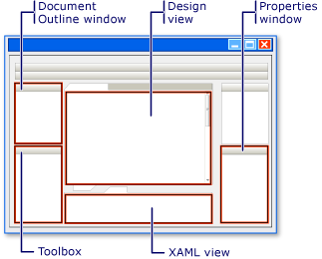
Wpf layout

Slide 7
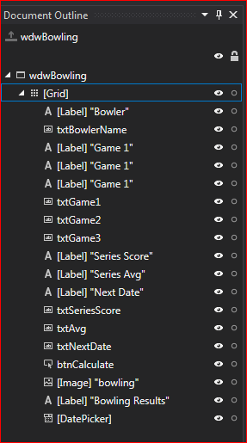
Document outine
Window object is on top
Grid is the next object
Everything else is a child of the grid
Some elements can have only one child, such as groupbox
Others can have many, such as grid
use this to choose your level
  Problem with resizing grid vs window

Slide 8
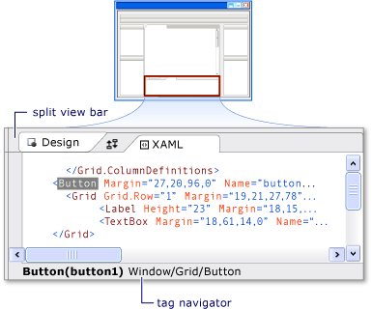
Xaml
Extensible Application Markup Language
  A type of language used to annotate text & imbed tags in accurately styled electronic documents
  Display is independent of:
    Operating system
    Computer platform
    Application
    Program

Slide 9
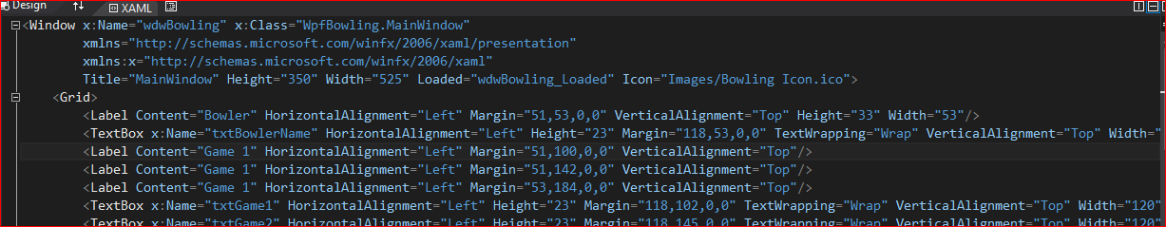
Xaml window
Format of the xaml tags – 2 formats
  <Textbox x:name = “name” Content= “bowler” />
Note how the grid surrounds everything else
  <Grid> …other stuff …. </Grid>

Slide 10
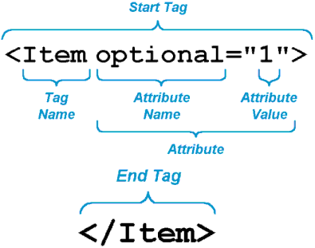
Xaml window
Tag definitions
Abiltiy to toggle xaml window and view on/off

Slide 11
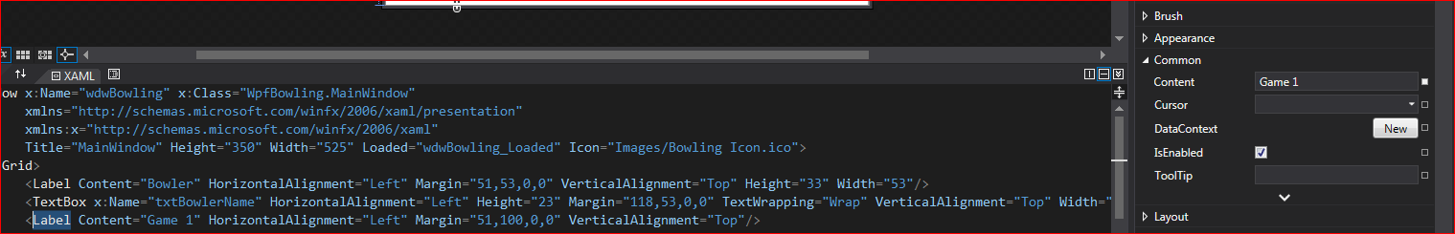
Xaml and property window
You can edit properties in the property window, or in xaml.
  Both are reflected instantly and do the exact same thing

Slide 12
IN class prep
Download OPEN BOWLING DESIGN and unzip
Create a new WPF project Bowling
Add provided icon in the windows icon property
Text: Bowling Results
Center on screen
Set the project icon
Add lblLeagueName to top of form:
league name here
Arial Rounded, 16, Blue
Centered in form

Slide 13
Update your program
Add a label for Bowling Team Name
Add a text box to the form
  Name the TextBox, size and position as necessary
  Set default value on the Text property to “enter team name”
    Note: recall that you can set a default value (value that is automatically entered when the TextBox is first created) by assigning text to the Text property at design time or at run time

Slide 14
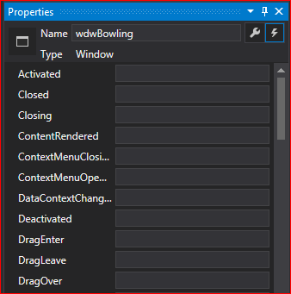
Creating event handlers
properties event handlers
There are many event handlers, not just the click event
what do you think that some of these mean?
Name your object, then double click in the box with the handler you wish to create

Slide 15
Update your program
Create an event handler for window Initialization

Slide 16

Text box properties
To clear the contents of a TextBox at run time, call the TextBox's Clear() method or set its Text property to "" (the empty string).
When appropriate (usually at run time), you can disable a TextBox so the user can’t type in it
  Set IsEnabled property to False to disable
  Set IsEnabled property to True to enable
You can limit the number of characters the user can type in the TextBox by setting the MaxLength property

Slide 17
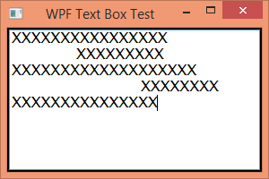

Text box properties
To create a TextBox that allows the user to enter more than one line of data, set the MaxLines and TextWrapping properties (and, of course, make the TextBox taller)
You can force the user’s entries to be all uppercase or all lowercase by changing the CharacterCasing property.
Commonly modified properties:
Margins, Height, Width, Font, ForeColor, BackColor, TextAlign, Visible
Margin = “left, top, right, bottom”
  wpf shows the distance when you move object

Slide 18
Update your form
Add label at top of page for “Bowling Score Summary”
Add threeTextBoxes and labels for scores 1-3
Set MaxLength to 3 for bowling scores
Align Center
Make bowler name multiline. Increase height. Reset multiline (remove)

Slide 19
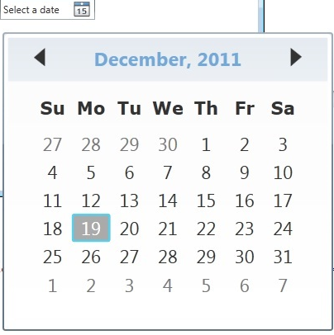
Date picker
DatePickers allow the user to easily enter date data into a program
Most DatePickers have a corresponding label to let the user know what the date represents
The date the user selects (or types) using the DatePicker is stored in the DatePicker’s Display Date property
  You can set a default date by assigning a date to the Value property at design time or at run time

Slide 20
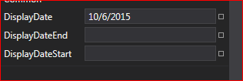

Date picker
You can limit the range of dates the user can select in the DatePicker by setting the DispalyDateEnd and/or DisplayDateStart property
You can change the way the date appears by changing the SelectedDateFormat property
Once the user has clicked the DatePicker drop down arrow, they can
  Click the year (on the calendar) to get up/down arrows to quickly change the year
Click the month (on the calendar) to get a list box of months to quickly change the month.

Slide 21
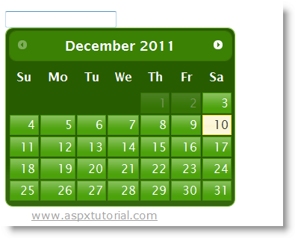
Date picker
Commonly modified properties:
Margin, Height, Width, Enabled, Font, ForeColor, BackColor, Text, Visible
The user can manually type a date by clicking in the month field then typing a date as they would in a TextBox with slashes between the month, day and year. The DatePicker focus automatically switches to the next field when the user types a slash.

Slide 22
Update form
Add a DatePicker and label above the Scores
Set minDate to 9/1/2005
Set maxDate to today
set date picker to today
Set the date format to Short and resize the date picker
Experiment with the DatePicker checkbox (remove when complete)
Try typing a date manually
Add output labels (auto size off, single border)
Add buttons to form
Add image (auto size)
Code Exit button
Code btnClear

Slide 23
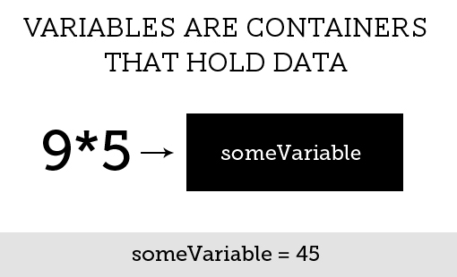
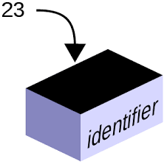
variables
Before we discuss sequential programming, we have to cover variables.
Every program uses variables to store values. Variables are memory locations (from your computer’s RAM) that are reserved for your program’s use.
Every input a program gets from a user is stored in a variable. Every result of a program’s calculations must be stored in a variable.

Slide 24
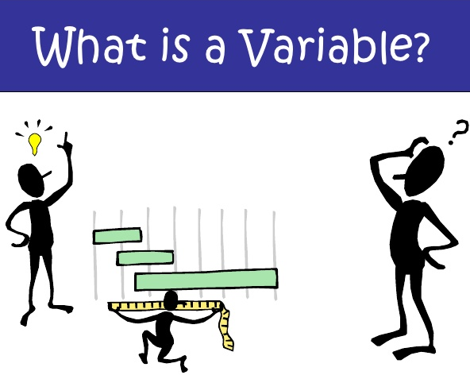
variables
C# does not know what variables your program needs, so you have to reserve memory or request memory as part of your program.
“How do I know what variables to declare?”
Your program design (IOP, TOE, FC, PC) provides your first clue.
  Every input will require a variable
  Every output will require a variable
  Intermediate results of calculations will require variables

Slide 25


variables
In C#, it is possible to use the contents of form objects (TextBoxes, DatePickers, etc) in calculations directly. However, you should generally copy the contents of form objects to variables for the following reasons:
  Processing variables is much quicker than processing form object contents.
  Calculations can not be done on text, which is what is in a TextBox.
  Debugging using variables is easier
  Good programming practice dictates it.

Slide 26

Declaring variables
Memory reservation is done by “declaring” a variable.
Declaring tells C#:
  you need a variable,
  what to call the variable,
  what type of data that variable will store and,
(optionally) the initial value for the variable

Slide 27
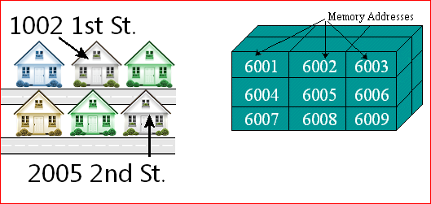
Memory handling
C# gets the appropriate amount of memory from the operating system based on the type of the variable.
C# then associates the name you specify with that memory location.
The memory location also has an “address” –its actual location in RAM.
You don’t need to worry about what the address of a variable is. C# takes care of translating the variable name into the address the operating system expects.

Slide 28

Naming variables
Variable names must start with a letter or underscore ( _ )
Additional characters must be letters, digits or underscore
(no spaces, periods, dashes, etc.)
No reserved words (aka: keywords)
  Have special meaning to C#. Would confuse compiler if used as a variable name.
  You’ll learn to recognize these as we go along.
Descriptive
  C# does not require this, but good programming style does
  Variable’s name must describe what is stored in a variable (makes code easier to read)
  Descriptive, but relatively brief
Within a method, two variables cannot have the same name.

Slide 29
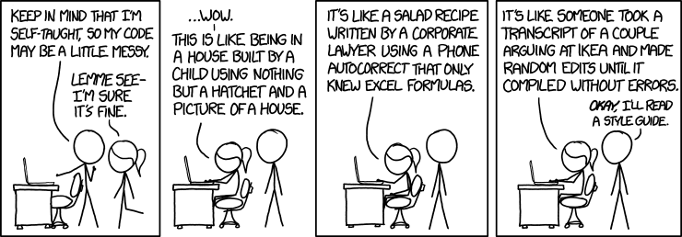
Code(and variable) quality

Slide 30

Naming variables
Naming conventions
  Every organization develops its own
  Our standard:
    Camel Case notation:
      First word in variable name is lowercase
      If there are more words in the variable name, all subsequent words start with a capital letter.
      Ex: variableName
      longerVariableName

Slide 31
Variables good/bad?
ccn
_openEnrollmentStart
a1
#sick_leave_accrual_rate_for_members
$string
one
Age-1
Xxxx
deptSubtotalOvertimeHours
deptSubtotalOvertimeHours2

Slide 32
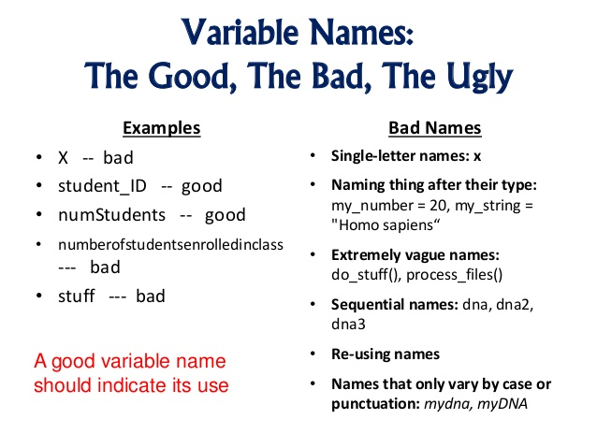

Slide 33
Naming variables
Also used-- Hungarian Notation, which is similar to camel-case but also includes a prefix for each variable that designates its type.
  .Net does not use this system
  Some shops use a single letter prefix; others use a 3-letter prefix.
  Ex: iAge dSalary sFirstName
  intAge dblSalary strFirstName

Slide 34
Variable types (common)
Variable types let C# know what type of data you plan to store in the variable.
Each variable can only store one type of data.
Type Size Comments
byte 1 byte Whole number, 0-255
short 2 bytes Whole number, ± 32,767
int 4 bytes Whole number, ± 2 billion
long 8 bytes Whole number, ± 9 billion
Comprehensive listing of data types:
http://www.tutorialspoint.com/csharp/csharp_data_types.htm

Slide 35
Variable types, part 2
Float- 32 bit precision. A number with decimals
Double – 64 bit precise decimal Number with decimals, larger numbers
Decimal – 128 bit precision. Use for number with decimal, currency
Char-16 bits. Single Unicode character
String- varies in size. Many characters (up to 2 billion)
Bool- Boolean (true or false)
DateTime- built in class.

Slide 36

Declaring default variables
As mentioned above, when you declare a variable, you must provide three pieces of information:
  the variable’s scope (discussed below),
  the variable’s type, and
  the variable’s name
If you wish, you can also provide an initial value for the variable.
Our programming standards also dictate that each variable be more thoroughly described using a comment
type name [ = initvalue ] ; //Description here
[ ] designate optional information

Slide 37


initializing variables
C# does not initialize its variables. You must initialize all
variables before you try to use them on the right side of
an equation.
  If you don’t, C# marks them as errors (uninitialized)
  Initialize variables either as you declare them (see above) or later in the code, but before the variable appears on the right side of the equal sign.
  When declaring variables, you can initialize them if
  necessary. Generally, programmers do not explicitly
  initialize variables when they are declared.
  The exception to this is string variables. It IS good practice to initialize strings to the empty string ( "")

Slide 38
Assigning to variables
Int finalValue = 5;
On the left
  The type of the variable and the variable name
On the right
  The value you are assigning to the variable
= vs ==

Slide 39
Practice making these variables. Include comments
employeeName – string
Age- integer
hoursWorked- double
hourlyWage- decimal
isMarried – Boolean

Slide 40
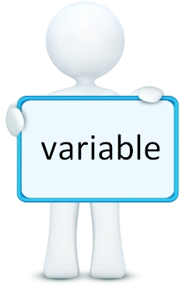
Notes regarding variables just created
  Each variable is declared using the appropriate type.
  Each variable’s name is descriptive, but not too long.
  Even though the variable names are descriptive, each variable is further described using an in-line comment.
    Our programming standards require that you provide a commented description for every variable you declare. Since C# ignores comments, it really doesn’t care.

Slide 41

Variable declaration
Also note, when you first declare a variable, C# will underline the variable with a green wavy line. This wavy line indicates that you have declared a variable but have not used it.
  Once you use a variable in an equation (see below), the wavy line will disappear.
  If you feel your method is complete but you still have the green wavy lines, those variables are probably unneeded and you should delete their declarations.

Slide 42
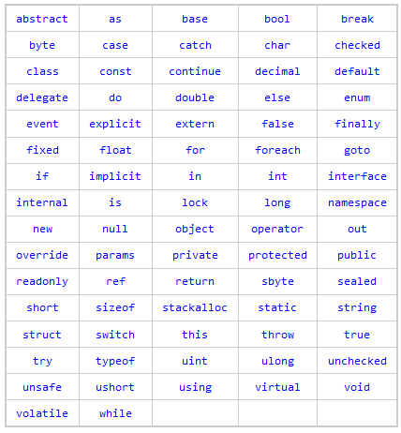
Variables cannot be keywords

Slide 43

Declaring datetime
DateTime can be declared in many ways
  Different methods to control the DateTime, what do they mean?
  What does new mean?
Most common example
  Can declare first, then assign.

Slide 44
assignment
Checkpoints 3.1-3.4 on page 121
Checkpoints 3.5 - 3.13 page 132-33

Slide 45
Do this on your file
In btnCalculate_Click
  declare variables for all inputs and outputs (from TOE):
  Integer: Game 1 – 3
  Integer: Series
  Double: Average
  DateTime: bowlDate
  DateTime: nextBowlDate

Slide 46
memory – further explanation
variables computer memory (very short)
https://www.youtube.com/watch?v=Dm-TDur-pSQ
Introduction to computer memory systems (from the start until 5:30)
https://www.youtube.com/watch?v=0IgdEPvMRCE

Slide 47


Setting default date in xaml
Add the sys reference to the top of the xaml file in exactly this location
Then add this to the <Datepicker> xaml

Slide 48
On your bowling program
Set the default date
you will need to do this on almost every project going forward

Slide 49
constants
Constants are program components that will not change
  String literals .. “surrounded by quotes”
  Boolean literals… true or false
  Integer literals … numbers without decimal place
    6 or 1233
  Double literals…numbers with decimal places
    3.14159 or .5
  Decimal literals… m designates this literal as a decimal number (m=money)
    125.75m

Slide 50

Constant naming
Named constants are similar to variables
  They are named memory locations
  The initial value MUST be provided
  Cannot change the value once assigned
Constants are usually in all CAPS
Use ‘const’ in front of declaration

Slide 51
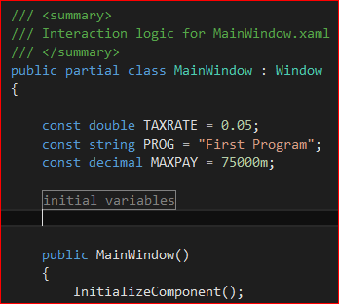
Constant location
Constants are often located at the top of the class

Slide 52
Update your program
Declare a constant
GAMESPERSERIES = 3
Declare another (form-level) constant LEAGUENAME

Slide 53
Intrinsic constant
An additional type of constant available in C# is an intrinsic constant
  Intrinsic constants are part of the language—they are predefined for your use and are always available.
  Often, they are part of enumerations—lists of intrinsic constants.
    Example: this.BackColor = Color.Red;
Red is an intrinsic constant (C# knows the value that results in the color red) that is part of the Color enumeration.

Slide 54
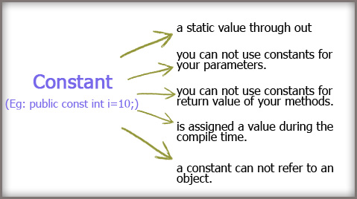
Constants vs literals
Why would I want to use (named) constants? Why not just use the literal value?
  Constants make programs easier to read (and therefore easier to maintain)
    taxAmount = totalSales * TAXRATE;
    is easier to decipher than
    taxAmount = totalSales * 0.055;
  Constants make programs easier to update.
  If you use the constant in many places throughout the program and then determine the constant's value needs to be changed (county tax rate changed), you only need to update one line of code (the constant declaration) instead of all the locations

Slide 55

When to use constants instead of literals?
When entering equations and you find yourself including a literal as part of the equation, ask yourself this question: could the literal value ever change?
  If you answer YES, it might change, DO use a named constant
  If you answer NO, it will never change, do NOT define a named constant (use the literal)
  HOWEVER, you might decide to use a named constant even when you don't need one to improve the clarity of your code.
The literal is 12..and it will never change- so use “12”
Tax rate may indeed change, so use a constant and set it to 0.055

Slide 56
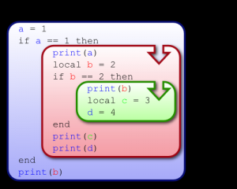
Variable scope
  Variable scope refers to the part(s) of a program that have access to a variable.
  Local
  Class –level
  Global

Slide 57
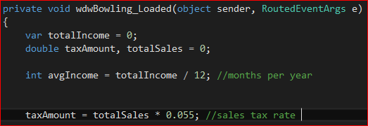
Local variables
Declared in method
Only available in that method
When method ends, memory returned to operating system.

Slide 58
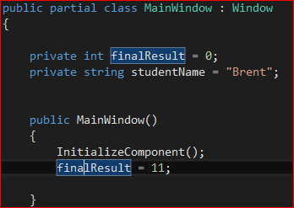
Class level variables
Book refers to these as fields
Declared outside of all methods, just under the partial class heading
Declared using private keyword
Available to all methods from any object on the form
Removed from memory when form is unloaded

Slide 59


Global Variables
Declared in a separate file called a code module, or as a public static int property
Code module: In C#: Project  Add New ItemCode File
Available to all methods in all windows
Removed from memory when project (program) ends
Only use of public declaration (outside of classes)
Assign the variable as noted above, then in the other window you can access it as noted below.

Slide 60


Where to declare variables
To make your program as memory efficient as possible, declare variables and constants at the lowest level possible.
  Initially, declare variables locally (within a method)
  If you discover more than one method must access the variable, make it class-level (a field).
  If you discover more than one form must access the variable, move it to a code module to make it global.
Exception: constants are rarely local. Start them out as class-level. Make them global only when necessary (multiple forms need access to constant).

Slide 61
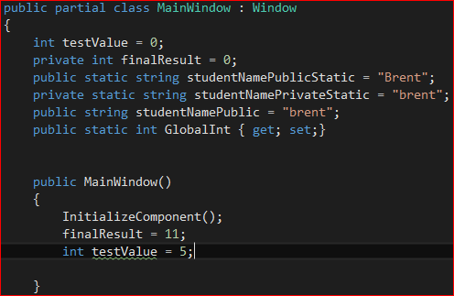
Multiple variable declarations
Can’t declare variable more than once in a method.
Variables with same name can be declared at each scope level (local, form, global)
  Method will use the variable with the closest scope (local, form, global)
Can be confusing. Normally don’t give form-level and local variables the same names

Slide 62
Sequential processing-input
  In object-oriented languages like C#, input is normally handled by the objects on a form.
    User enters data in a TextBox, selects a date from a DateTimePicker, selects a RadioButton, etc.
  Once you've added these objects to a form, no additional coding is required to get them to accept user input.

Slide 63
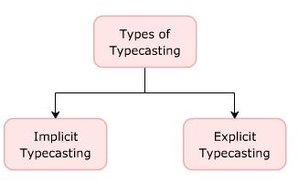
Converting data types
Users normally enter data into TextBoxes. The TextBox Text property is of type string.
C# does not allow the implicit (automatic) conversion from strings to numbers.
Therefore, you'll have to learn how to explicitly (manually) convert strings to numbers.

Slide 64
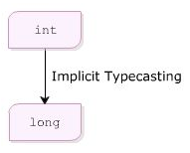
implicit typecasting
done automatically by the compiler
  moves a lower precision data type to a higher precision one
  1 to 1.00 for example
  int to long, although they would appear the same

Slide 65
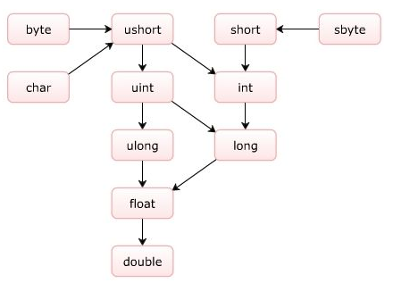
implicit castings

Slide 66
Types of conversions
Implicit conversions: No special syntax is required because the conversion is type safe and no data will be lost. Examples include conversions from smaller to larger integral types,
Explicit conversions (casts): Explicit conversions require a cast operator. Casting is required when information might be lost in the conversion. Typical examples include numeric conversion to a type that has less precision or a smaller range.

Slide 67


Explicit conversions
parse – tells the program to interpret a string
  int.parse(variable);
casting – tell compiler that an object is really something else, without changing it. may have data loss
  vNewDataTypevariable= (int)vOldDataTypeVariable;

Slide 68

conversions of decimal
c# won’t allow conversion of Deicmal to any type of integer (byte, long, etc) implicitly. It’s a narrowing conversion.
  for example, salary being rounded to the nearest $1- you lose precision.

Slide 69

Parse method
variabletype.parse is the format
  int.parse
  double.parse
  decimal.parse
These methods do not handle empty strings (ie- the text box is empty). Runtime error.
Do not handle $, %, or commas. We will use validation to ensure proper text later on

Slide 70

Not all controls need to be converted
Date picker will not need to be converted, for example
Any string variable will need no conversion

Slide 71
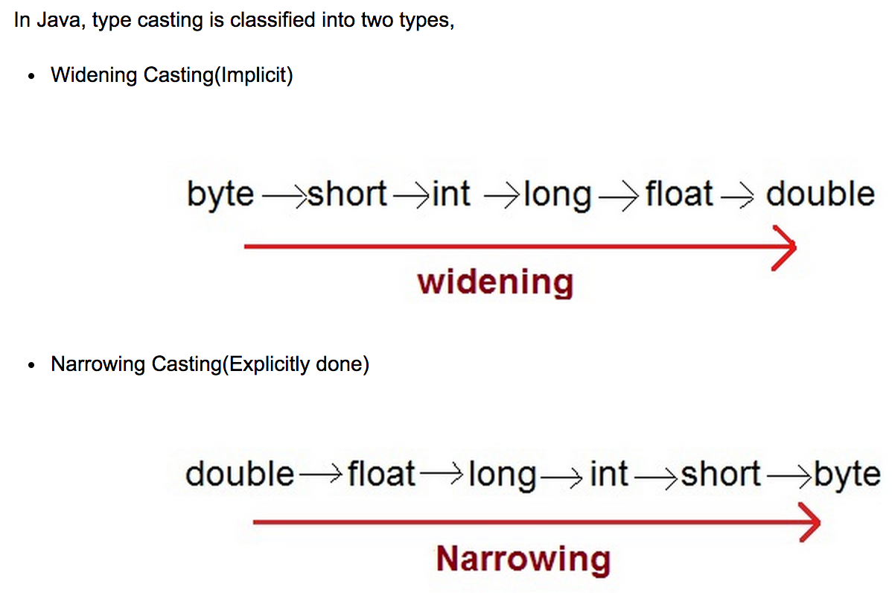
Widening and narrowing conversion
As you narrow the data type, you have a loss of precision

Slide 72
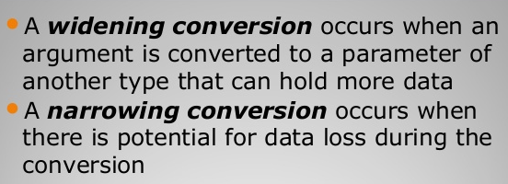


conversion comparison

Slide 73
How to test using debugger
Place a break point
Run the program
Review the information presented

Slide 74
Update bowling program
(btnCalculate_Click)
Convert the data from the TextBoxes and store the values in the appropriate variables.
transfer the value from the date picker to the variable
Test (using debugger and breakpoint)
  demo that this works for me and/or the lab asst

Slide 75
Next assignment
Rental Gas Cost Estimate Program
  must be done in WPF
  due in 2 weeks
Checkpoints 3.14-29
  due in 1 week
  I'm combining the checkpoint scores for this chapter into one score on blackboard (10 points)

Slide 76
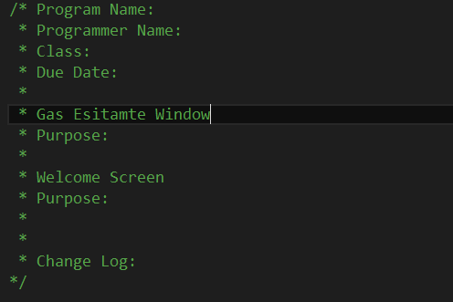
Project Level Documentation placed in it's own class

Slide 77
Creating a Welcome Screen
create a new window
within the new window create Timer method and a dispatch timer method. Add the code listed to each of these classes (next 2 slides have the text so you can copy the text)

Slide 78
Timer method
private void Timer()
{
initialTicks = DateTime.Now.Ticks;
System.Windows.Threading.DispatcherTimer dispatcherTimer = new System.Windows.Threading.DispatcherTimer();
dispatcherTimer.Tick += new EventHandler(dispatcherTimer_Tick);
dispatcherTimer.Interval = new TimeSpan(0, 0, 1);
dispatcherTimer.Start();
}

Slide 79
Timer_Tick method
private void dispatcherTimer_Tick(object sender, EventArgs e)
{
//update the lable which displays the current second
lblTimer.Content = DateTime.Now.Second;
// Forcing the CommandManager to raise the RequerySuggested event
CommandManager.InvalidateRequerySuggested();
finalTicks = DateTime.Now.Ticks;
long elapsedTicks = finalTicks - initialTicks;
if (elapsedTicks > 50000000) //10000000 ticks per second
{
Application.Current.MainWindow.Show();
this.Close();
}
}

Slide 80
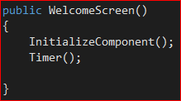
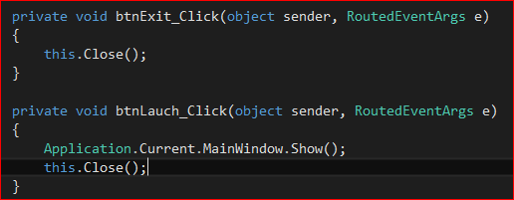
welcome screen
create 2 buttons & click event handlers
  exit button
  launch application button
  Add Timer() to WelcomeScreen constructor

Slide 81
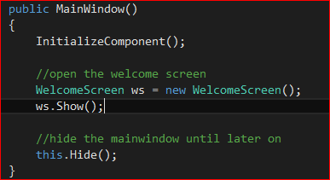
within the main window cs file
create a new instance of the welcome screen, and then show it
hide the main window until you need it later

Slide 82
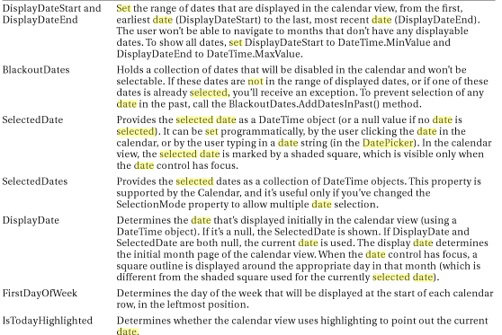
date picker properties

Slide 83
how to handle datepicker selected date
Cannot use DisplayDate to key upon because the date you wish to calculate from may not be today
must use SelectedDate property instead
  this is a nullable DateTime
  what is nullable? How to handle this.
DateTime currentDate = dtpBowlingDate.SelectedDate?? DateTime.Now;

Slide 84
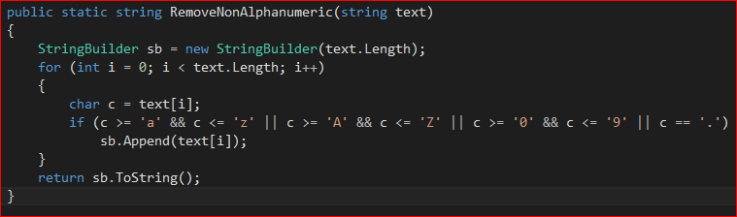
method to remove non-numeric characters
We want to remove non-numeric characters when pulling the currency value from a label or textbox
add this method to your program

Slide 85
Text of removenonalphanumeric method
public static string RemoveNonAlphanumeric(string text)
{
StringBuilder sb = new StringBuilder(text.Length);
for (int i = 0; i < text.Length; i++)
{
char c = text[i];
if (c >= 'a' && c <= 'z' || c >= 'A' && c <= 'Z' || c >= '0' && c <= '9' || c == '.')
sb.Append(text[i]);
}
return sb.ToString();
}​

Slide 86
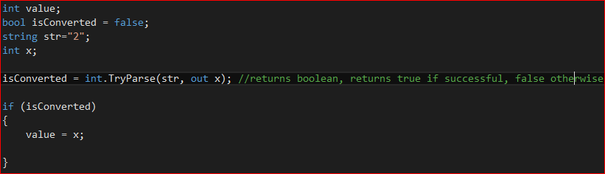

Slide 87
sequential processing-calculations
once the user has entered data, you will need to process it using calculations
answer = number1 + number2 is the format
operators
+(addition) –(subtraction)
*(multiplication) /(division)
% (modulus) – remainder only of division

Slide 88
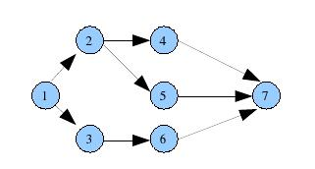
order of precedence
when an equation contains more than one operator, they are processed in a specific order
() – override the order
* / %
+ -
if 2 operators have the same order of precedence, go from left to right

Slide 89
examples
1+2*3
(1+2)*3
1+(2*3)
(7%3)
(4+(6/3))
(7%4) * (4+(6/2))
(10-1*2)/((2+(8%3)
15-6/3
15/5*3

Slide 90
integer division
A confusing and potentially dangerous feature of C# is how it handles integer division.
Integer division is defined as dividing a number that is an integer (any type of integer) by another integer value.
When dividing an integer by an integer, C# always returns an integer. Any decimal places are discarded.
If you wish to retain the decimal places, you must convert one of the operands (values) to a double.
Integer division is division in which the fractional part (remainder) is discarded

Slide 91
division rounding (from msdn)
The division rounds the result towards zero, and the absolute value of the result is the largest possible integer that is less than the absolute value of the quotient of the two operands. The result is zero or positive when the two operands have the same sign and zero or negative when the two operands have opposite signs.

Slide 92


integer division
because both are integers, c# does integer division. The end result is 25 (the .6 is discarded, not rounded)
if we cast totalAge as a double, the result uses double division. c# automatically casts numStudents as double

Slide 93

mixed type math
If an equation contains a mix of doubles and integers, the end result of the equation is a double.
Any integers in the equation are temporarily converted to doubles so that all the equation parts are of the same type.
Equations can include a mix of bytes, shorts, integers, longs, singles, doubles and decimals.
All smaller types (listed first in the list above) are temporarily converted to largest type included in the equation and the equation result is the same type as the largest type in the equation.

Slide 94


Doubles and Decimals
doubles and decimals are not converted implicitly
casting the discount as a decimal eliminates syntax errors

Slide 95
examples
int + int = int
int + double = double
intresult = int + double + int …. error

Slide 96
update your program
in btnCalculate_Click event
  enter equations to calculate the series total and average
  declare a constant GAMESPERSERIES = 3
Place breakpoint in event handler of btnCalc. Run. Enter 100, 100, 101 Note the average calculation is using Integer division.
  cast either operand of the division equation to double and confirm there is double division

Slide 97
modulus
The % operator (short for modulus or sometimes modulo) returns the remainder of a division.
% is normally used on integers, resulting in an integer.
  For example, let's say we have 77 eggs and want to know how many will be left over after the eggs are placed into cartons that hold a dozen eggs each leftOver = eggs % 12;
The variable leftOver will have value of 5
(77 / 12 = 6 with 5 leftover) eggs is another variable that somehow got the value 77 assigned to it (probably user input)
Note I used the literal 12 here, not a named constant, because the number of eggs per dozen won't change. I could have used a constant
EGGSPERDOZEN for clarity.

Slide 98
modulus examples
10%4
3%4
5%3
12%5
10%10
0%4
4%0

Slide 99

date calculations
The DateTime class comes with a couple of built in methods to allow you to do calculations

Slide 100

tostring method
Converts a variable (or an object) to a string
  basically the opposite of parsing the string into an integer
the ToString() method is very useful as a formatting tool as well.
  datetime, for example

Slide 101

datetime formats
DateTime also includes a ToString() method
if you transfer DateTime values to a label using ToString, the date will be formatted like this:
  6/1/2015 4:22:44 PM
if you create a custom date with no time, it will show up like this
  5/7/2015 12:00:00 AM

Slide 102
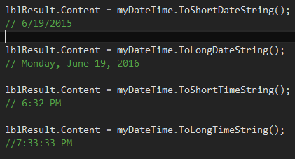
datetime tostring() methods
custom ToString() methods for DateTime

Slide 103
Addl datetime formatting
> If the above formatting commands don't meet your
needs, C#, specifically the DateTime ToString method, has the ability to create custom formats.
Formatting codes d, D, t and T duplicate the short date, long date, short time and long time formats described above.
More date/time customization codes (remember to put in quotation marks)
Demonstrate DateTime format program

Slide 104
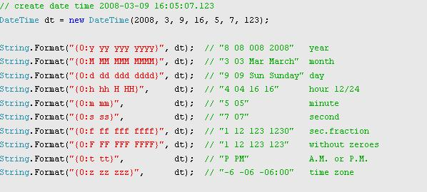
datetime formatted ex’s

Slide 105
update your program
format the next bowling date
  use two different formatting types and then decide which one you like the best

Slide 106
datetime tostring formats
msdn custom Date and Time format strings
  https://msdn.microsoft.com/en-us/library/8kb3ddd4(v=vs.110).aspx
DateTime tostring patterns
  http://www.geekzilla.co.uk/View00FF7904-B510-468C-A2C8-F859AA20581F.htm

Slide 107
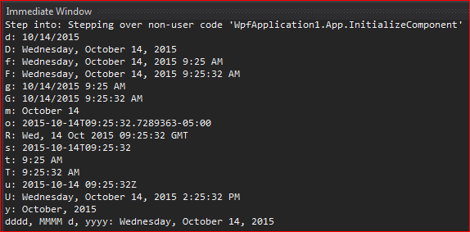
wpf demo of datetime
some sample DateTime formats

Slide 108
update program
calculate the next league day (days + 14) and display it in a label under this week’s date
checkpoint 3.18-3.24 (review only, do not turn in)

Slide 109
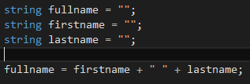
string processing
concantenation – the process of putting multiple strings together to make a new string
use the + symbol to concantenate

Slide 110

concantenation details
the concantenation operator will convert any datatype to string in order to put the string together
concantenate the following:
  “my age is” and intAge;
  “current date and time is “ + DateTime.Now;

Slide 111
update your program
create a variable to hold a working version of the league name
initialize the variable
concantenate “league :” and the league name constant

Slide 112
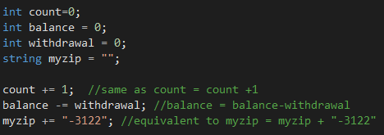
combined assignment operators
a combination of = with a traditional operator
+=, -=, *=, /=

Slide 113

increment and decrement operators
shorthand for incrementing or decrementing an integer

Slide 114

formatting output
Program results are normally displayed in labels
  these are all strings, so you need to convert your numbers to a string in order to display them
you can force any variable to be a string by calling the ToString() method.

Slide 115

formatting using tostring()
Your data will often need formatting
  too many decimal places
  commas, or dollar signs to be added, etc
ToString() can be customized to let the method know how the value should be formatted
  ToString(n), ToString(n1), ToString(c)
  n2 = 2 decimal places, c2 = 2 decimal places

Slide 116
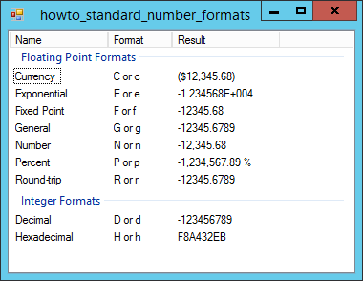
tostring() formats

Slide 117
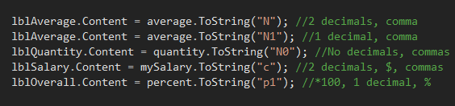
formatting examples
ToString(LetterNumber) format
formatting codes are only used when transferring values to outputs..not used to limit number of decimals in calculation

Slide 118
update your program
run the program again using 110, 110, 100 as scored
format the average as n and then as n1
checkpoint 3.30-3.34(review only)

Slide 119

syntax vs logic errors
Syntax errors occur when you break the rules of the programming language.
In C# these errors or easy to recognize because VS underlines syntax errors with red wavy lines.
Knowing how to correct syntax errors is a matter of experience and comparing your code to the notes.
The most common syntax errors
  forgetting the semicolon (;)
  forgetting ( ) after method calls.
  working with incompatible data types
You will not be able to run your program until all syntax errors are removed.

Slide 120

runtime errors
Runtime errors occur when a running program crashes.
  Program functions normally most of the time, but certain circumstances cause it to crash.
  You need to discover what is causing the crash. The VS debugger can help.
  Examples:
    Divide by zero
    Try to convert an empty TextBox into a number
    Calculate with a blank field

Slide 121
Logic errors
Logic errors are a type of runtime error
  some cause the program to crash because it encounters unexpected circumstances
    empty fields
  other errors cause the program to continue, but give improper results
    ex: bowling average = game1+game2+game3/3 if you use the wrong order of precedence
  Difficult to identify

Slide 122
Assignment
Math Program

Slide 123
Finalizing an application
Tab order
Focus
Accept/cancel
Anchoring controls
Welcome screen
Catching exceptions

Slide 124
Assignment
Complete lab 1 – improving usability

Slide 125
Tab order
When you run a program, C# visits the objects on the form in the order they were placed on the form
You can rearrange the tab order by changing an object’s TabIndex property
  Tab index starts at 0
  When you change a TabIndex, all objects with a higher (or equal) number TabIndex will automatically renumber

Slide 126
Tab order
Within the properties (or the xaml), change the TabIndex property in the order you wish them to be set
  To stop the control from being in the tab lineup
    Set IsTabStop = false

Slide 127

Focus method
Allows moving focus (object currently in use) at runtime.
Often applied after command button code to place focus on the appropriate object (after printing or clearing form or calculating values for instance)
Objectname.Focus( );

Slide 128
Locking an object
Change any object’s Locked property to True
Keeps you from accidentally moving or resizing an object on a form once you’ve placed it appropriately.
You can still change any property (including size and location), but can’t change object with the mouse
You can also, right-click on an empty area on the form and select Lock Controls to lock all the objects on the form and the form itself

Slide 129
Shortcut keys
In the content property place an underscore prior to the letter you wish to tie with alt
  _Cancel would be alt-c
  Additional binding is necessary
  Letter will be underlined if you press the alt button

Slide 130
Accept/cancel buttons
  C# allows you to designate one button on the form as the default button.
    the default button is what is executed when the user presses enter
    IsDefault = true on any button
The cancel button is the one which is executed if the user presses ESC.
  IsCancel = true;
If another button has focus (see above), that button will be clicked if the user presses enter. When any non-button object has focus, the Accept button clicks when the user presses Enter.

Slide 131
Update your program
Set the calc button a the accept button
Press enter after entering last game
Press tab to focus on exit
Press enter

Slide 132
Anchoring controls
  When users resize a form, it is often more professional for some form objects to retain their relative position on the form
Titles should remain centered
Exit buttons should stick to the bottom,right corner of the form
To retain these positions, objects need to be anchored to one or more sides of the form

Slide 133
Anchoring controls
  By default, all objects are anchored to the top, left corner of the form
  These objects don’t move when the form is resized
  Anchoring a centered object
    Select the object
  To anchor the exit button on the bottom right of the window
    Margin = “0,0, 10,10”
    horizontal alignment=right
    vertical alignment=bottom

Slide 134
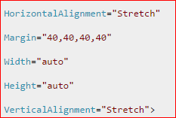
Anchor a resizing exit button
Use these properties

Slide 135
You can either set the HorizontalAlignment and VerticalAlignment on the TreeView or Button (I cannot tell which control you are trying toanchor), or you could place the control inside a DockPanel. To space the control away from others use the Margin. To achieve anchoring, Set following properties: Width="auto

Slide 136
Adding a welcome screen
  Professional products often start with a Welcome screen or a Splash Screen
Right click on project, add new window
  Call you window “welcome screen”

Slide 137
Assignment
Complete lab 2 – adding a welcome screen

Slide 138
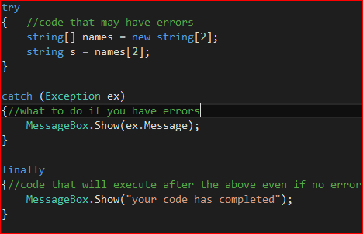
Try – catch - finally
In every program, things go wrong sometimes. With C#, we have a good compiler, which will help us prevent some of the most common mistakes.
It can't see every error that might happen, and in those cases, the .NET framework will throw an exception, to tell us that something went wrong
What if we want to handle errors ourselves?

Slide 139
Assignment
Complete lab 3-catching exceptions

